Slide 1
How does multiple regression work?
https://qitools.ocpu.io/charts/www/

Slide 2
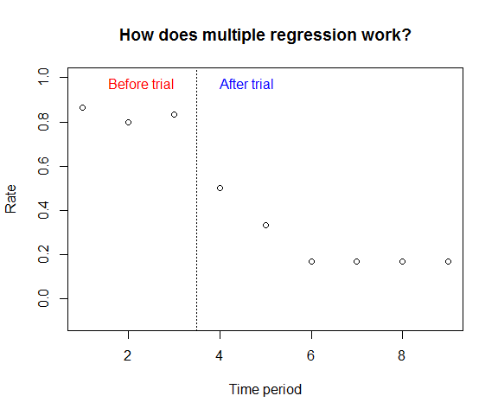

Slide 3
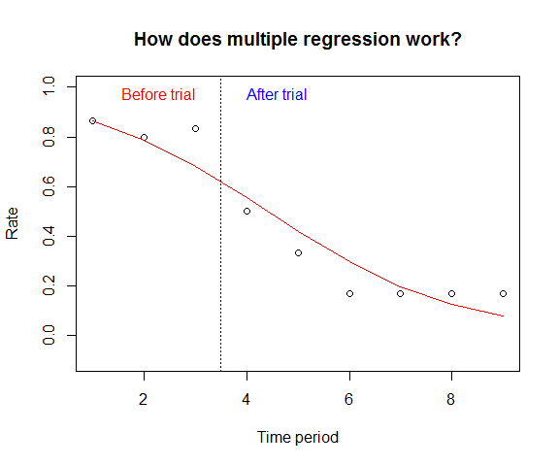
Lets place a line that shows the regression of time period and rate.

Slide 4
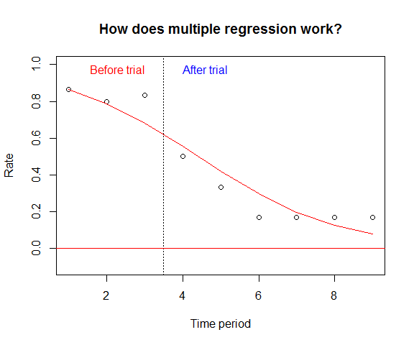
Now, let’s move that line to “0”.

Slide 5
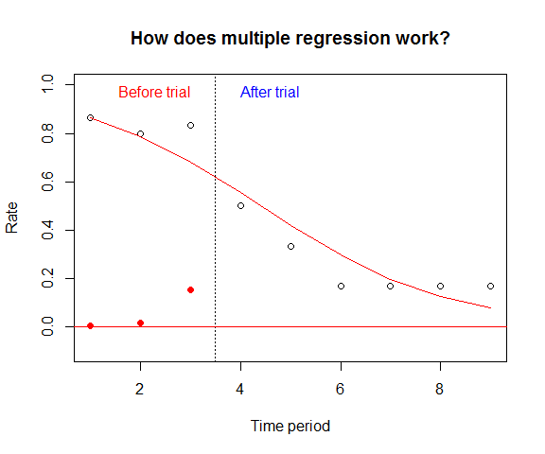
Lets replot the ‘Before trial’ values about the 0 line. Note how the first two points are one the line and the third remains above the line

Slide 6
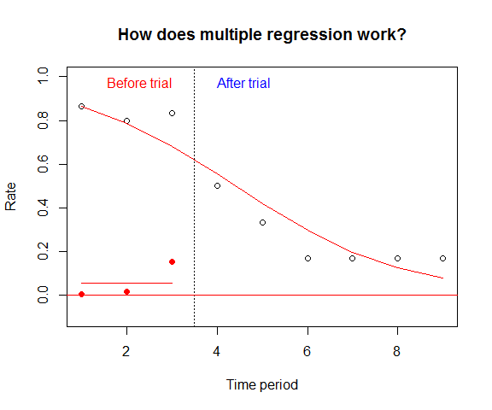
Ok. Let’s plot the mean of the three values

Slide 7
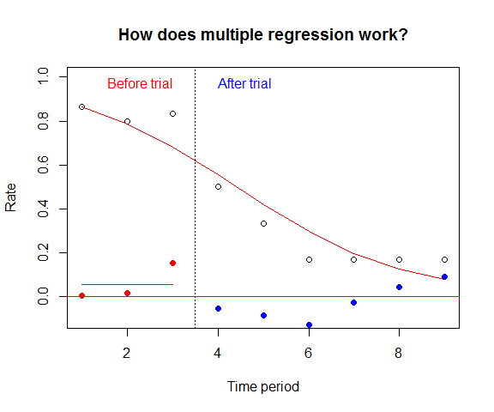
Now, do the same for the ‘After trial’ values.

Slide 8
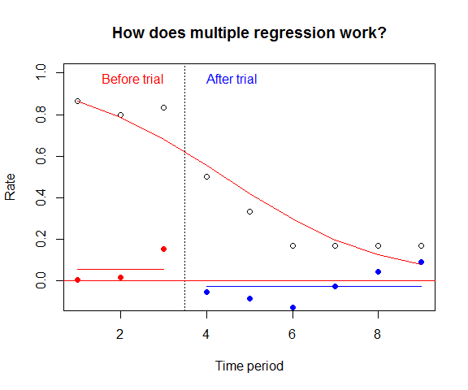
Finally, add the ‘After trial’ mean.
Note that, after controlling for time period, there is a difference in the mean before and after the trial.

Slide 9
References
Taljaard M, McKenzie JE, Ramsay CR, Grimshaw JM. The use of segmented regression in analysing interrupted time series studies: an example in pre-hospital ambulance care. Implement Sci. 2014 Jun 19;9:77. doi: 10.1186/1748-5908-9-77. PMID: 24943919; PMCID: PMC4068621.

